Slide 1

Ms Paint
Project
University Of Punjab

Slide 2


Members
Anoosha Imran
Malika Shoukat
Ayesha
Zarafshan

Slide 3
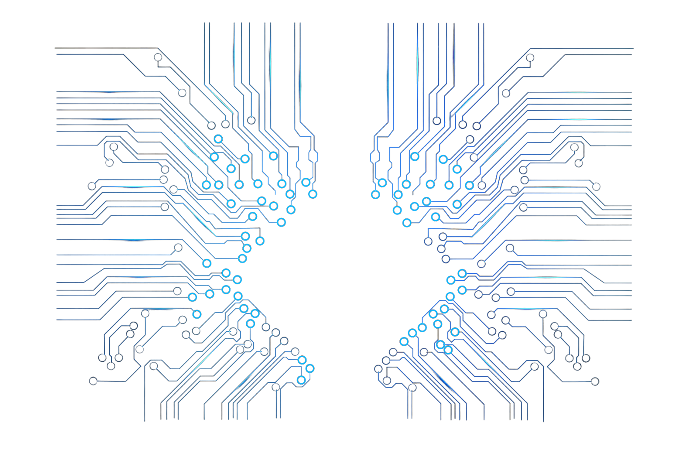
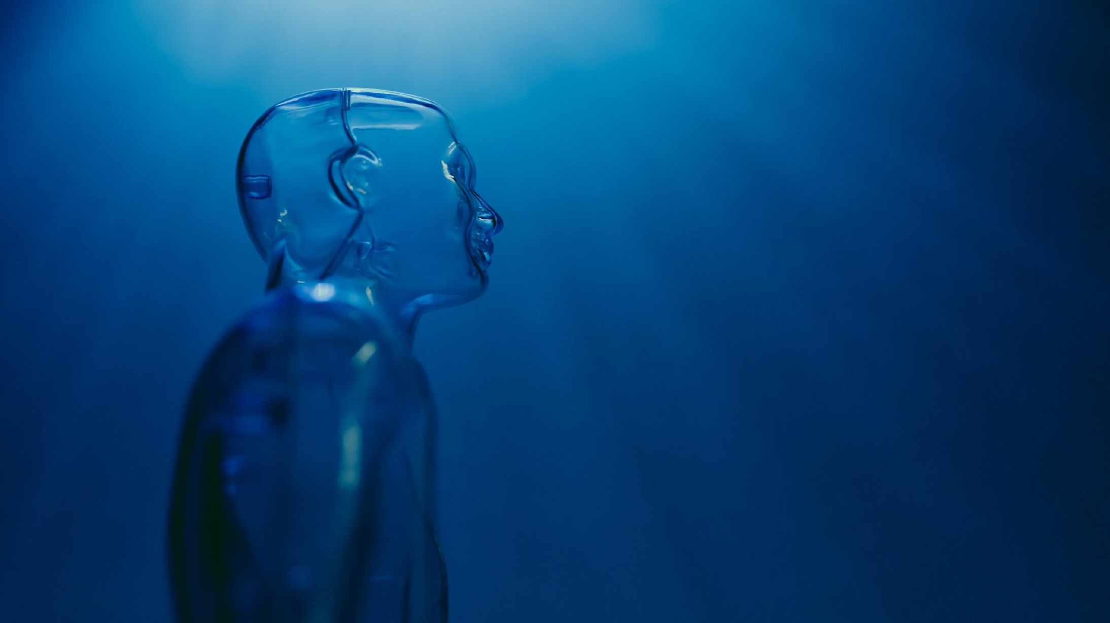
Introduction
The program is a modified variant of MS-PAINT giving the user a list of options to choose from.
It has the ability to allow user to draw shapes of different types.Not only that, it can lead you to a horizon of drawing shapes and patterns of your very own choice if you donot want to print the already available shapes.
having said that, all the shapes can be saved and printed in the choice of file you want to them to and can add anything to them or even replace them in the files they are saved, the way you would like.

Slide 4
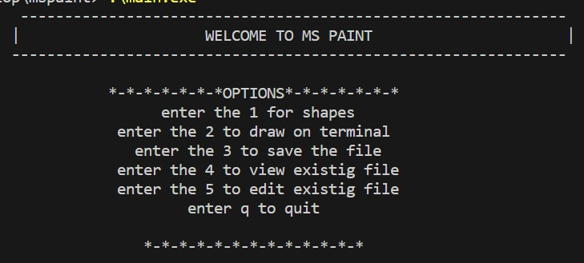
Main Menu
Description
Starting off , Our main menu will show the following option

Slide 5
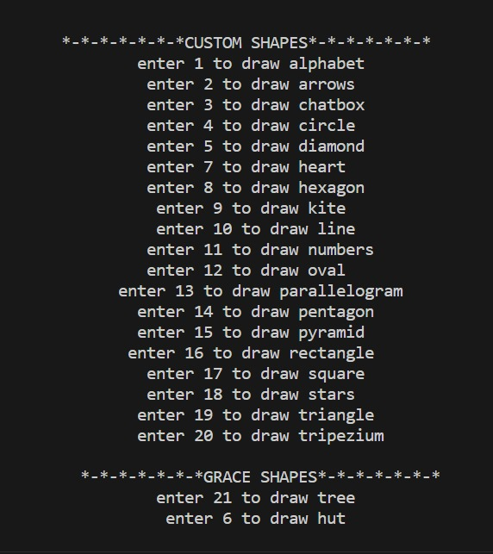
Option 1
Description :
After selecting the First option, the user will be prompted to chose the shape he/she wants to draw
VISON

Slide 6

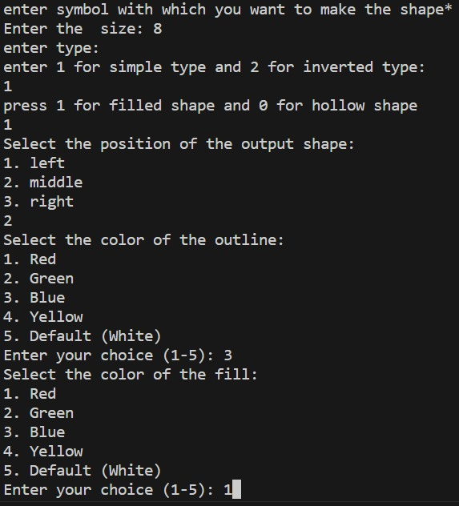
Option
Description
Every shapes has it own characteristics to be fulfilled by user in order to have the choice of user involve at premium level

Slide 7
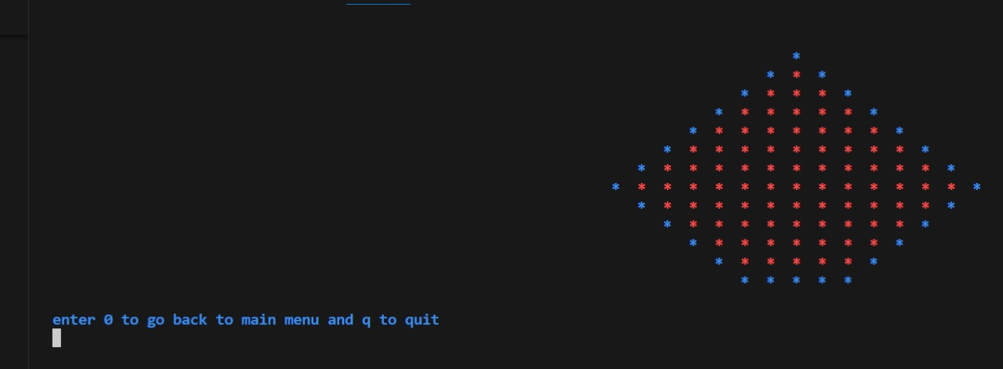
Option
Shape drawn and first option is completed here

Slide 8
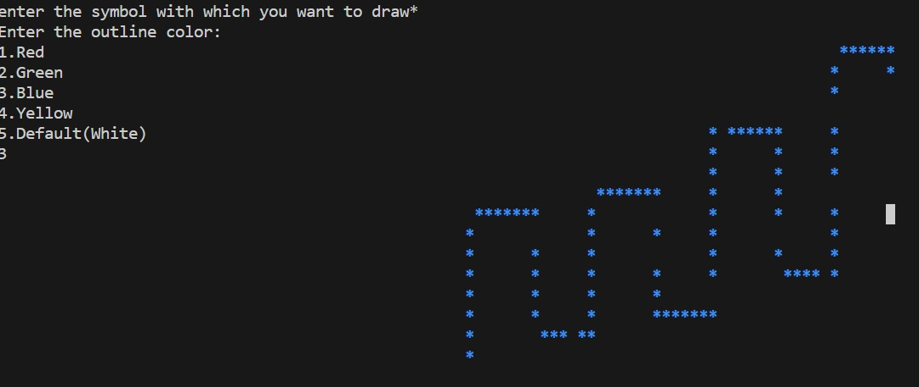
Option 2
The second option allows the user to get into a horizon of making his own Shapes with the choice of color and symbol he/she wants to

Slide 9

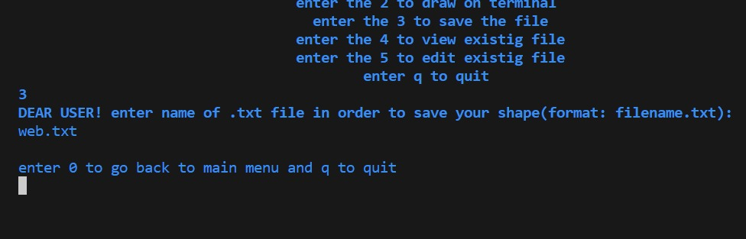
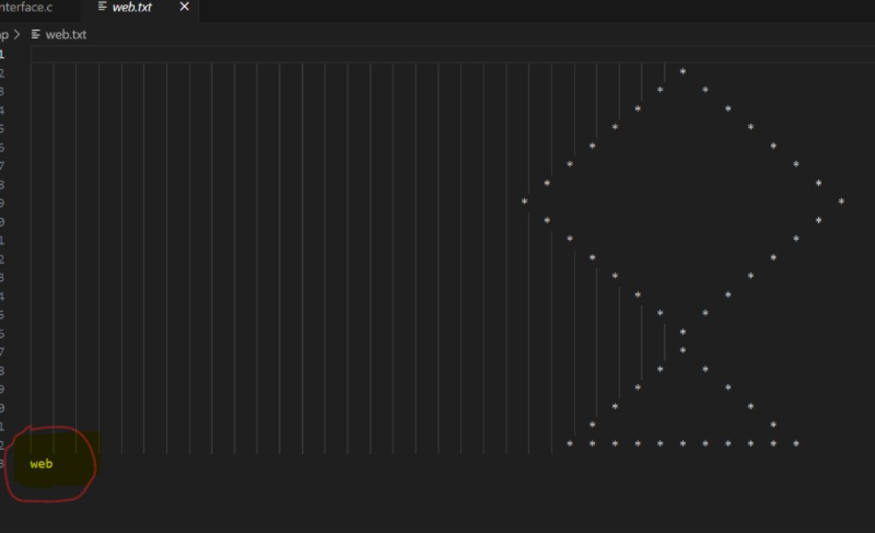
Option 3
Now here comes the 3rd option of our project which is basically serving for saving the shape in the user defined file. It will prompt the user to enter the name for the file and then save it in that automatically
File is saved in the web.txt (user defined file)

Slide 10
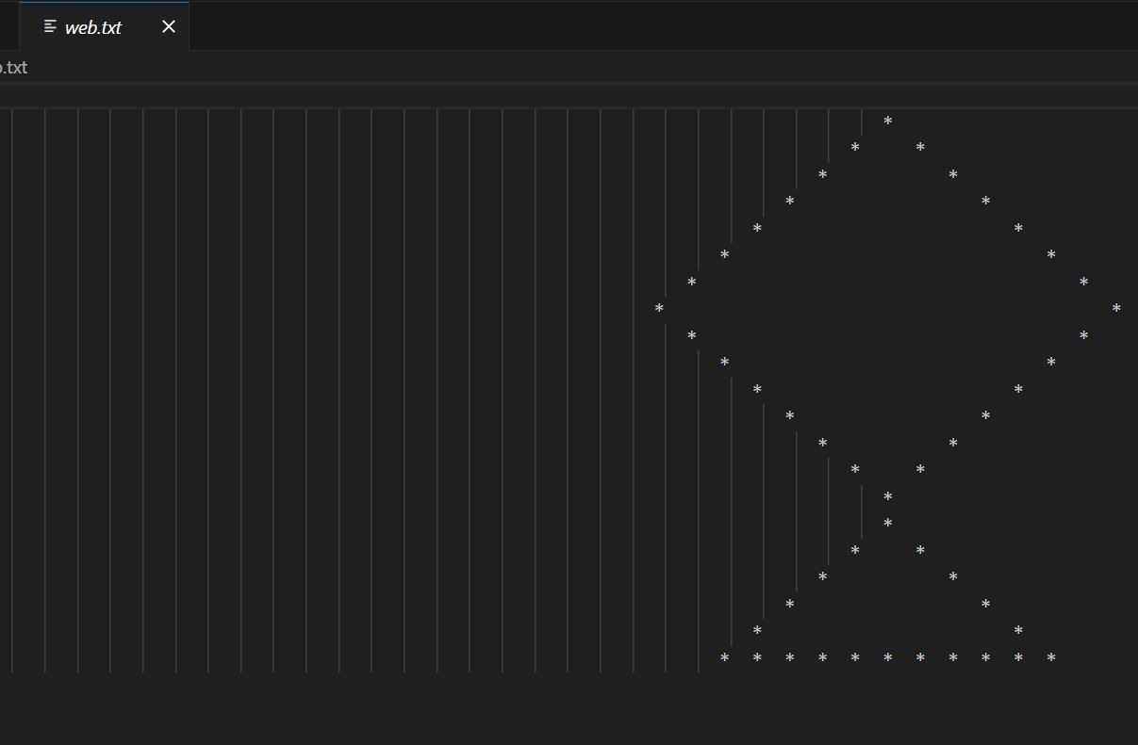
Option 4
is letting the user view a data stored in any file he namesFor instance: here web.txt was the file given to view data from and it performed accordingly!

Slide 11
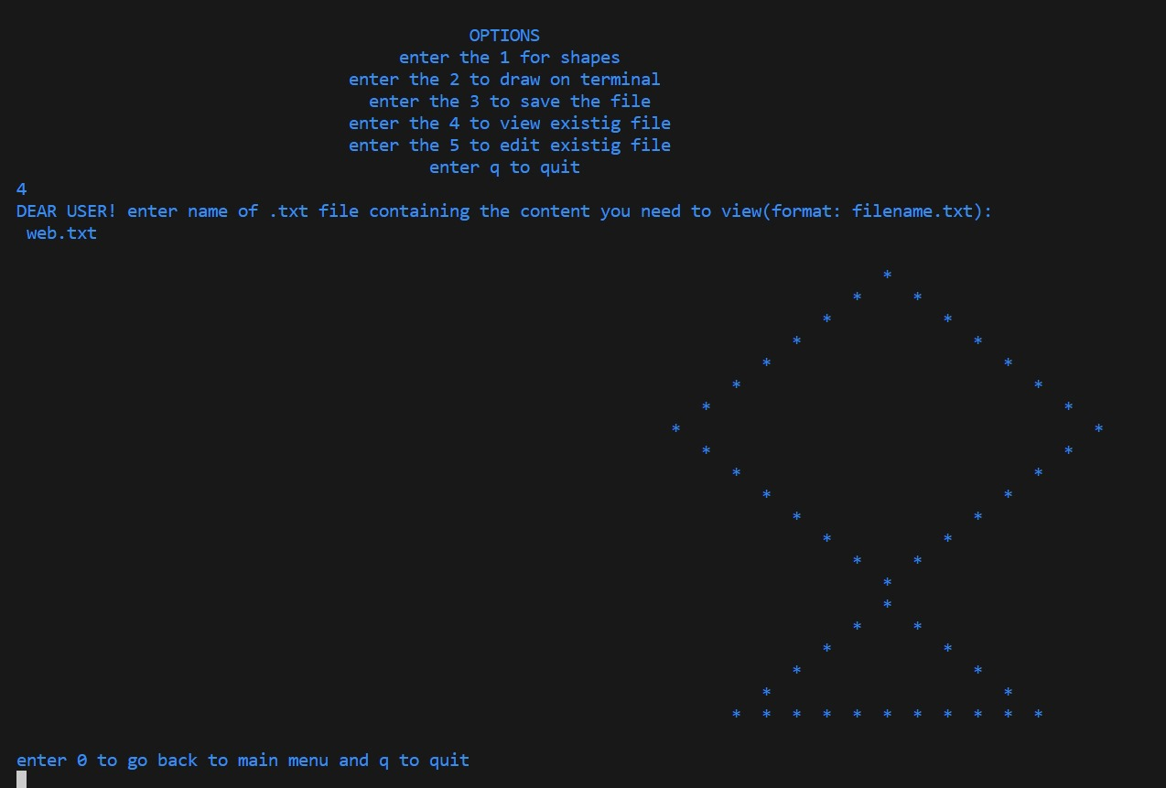
Option 5
Option 5 has two parts:
1-user can append file he wants to
2- user can write to the file he wants to

Slide 12

1-user can append file he wants
Here user has opted for appending the file with word "web" and it has been done precisely by the program

Slide 13
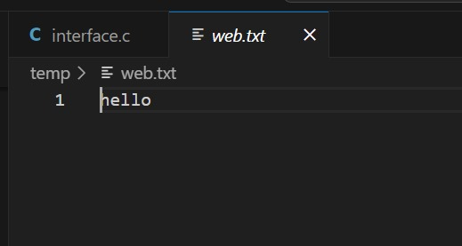
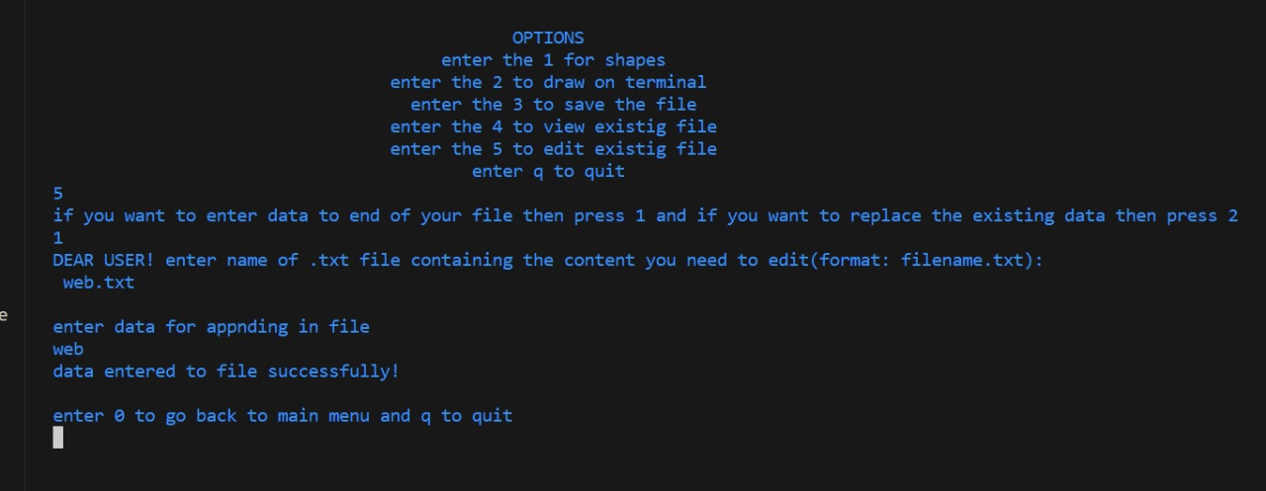
2- user can write to the file he wants to
Here user is opting for writing in the file and it also has been done accurately by the program

Slide 14
THANK YOU!

